Slide 1
File Transfer Protocol

Slide 2
File Transfer Protocol
File Transfer Protocol (FTP) is the standard mechanism provided by TCP/IP for copying a file from one host to another.
Differs from other client/server applications in that it establishes two connections between the hosts. One connection is used for data transfer, the other for control information (commands and responses).

Slide 3
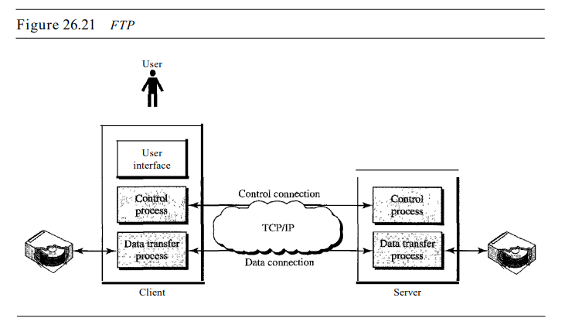

Slide 4
Communication over Control Connection
FTP uses the same approach as SMTP to communicate across the control connection. It uses the 7-bit ASCII character set.
Communication is achieved through commands and responses. This simple method is adequate for the control connection because we send one command (or response) at a time.
Each command or response is only one short line, so we need not worry about file format or file structure.
Each line is terminated with a two-character (carriage return and line feed) end-of-line token

Slide 5
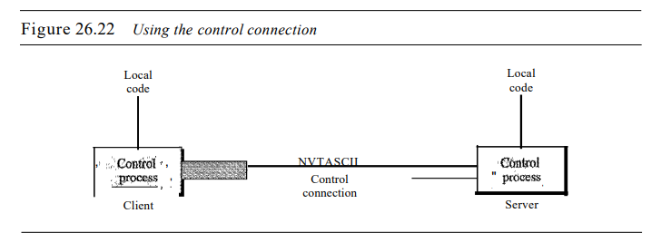

Slide 6
Communication over Data Connection
file transfer in FTP means one of three things:
o A file is to be copied from the server to the client. This is called retrieving aft/e. It is done under the supervision of the RETR command.
o A file is to be copied from the client to the server. This is called storing aft/e. It is done under the supervision of the STOR command.
o A list of directory or file names is to be sent from the server to the client. This is done under the supervision of the LIST command. Note that FTP treats a list of directory or file names as a file. It is sent over the data connection.

Slide 7
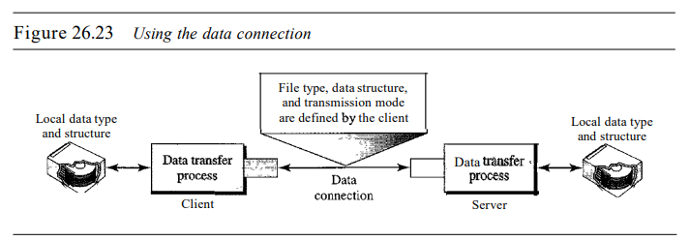

Slide 8
File Type
FTP can transfer one of the following file types across the data connection: an ASCII file, EBCDIC file, or image file.
The ASCII file is the default format for transferring text files. Each character is encoded using 7-bit ASCII. The sender transforms the file from its own representation into ASCII characters, and the receiver transforms the ASCII characters to its own representation.
If one or both ends of the connection use EBCDIC encoding (the file format used by IBM), the file can be transferred using EBCDIC encoding.
The image file is the default format for transferring binary files.

Slide 9
Data Structure
FTP can transfer a file across the data connection by using one of the following interpretations about the structure of the data:
file structure, record structure, and page structure.
In the file structure format, the file is a continuous stream of bytes. In the record structure, the file is divided into records.
This can be used only with text files.
In the page structure, the file is divided into pages, with each page having a page number and a page header.
The pages can be stored and accessed randomly or sequentially.

Slide 10
Transmission Mode
FTP can transfer a file across the data connection by using one of the following three transmission modes:
stream mode,
block mode, and
compressed mode.

Slide 11
The stream mode is the default mode. Data are delivered from FTP to TCP as a continuous stream of bytes.
If the data are divided into records (record structure), each record will have a I-byte end of-record (EOR) character and the end of the file will have a I-byte end-of-file (EOF) character. In block mode, data can be delivered from FTP to TCP in blocks. In this case, each block is preceded by a 3-byte header. The first byte is called the block descriptor; the next 2 bytes define the size of the block in bytes.
In the compressed mode, if the file is big, the data can be compressed. The compression method normally used is run-length encoding. In a binary file, null characters are usually compressed

